Slide 1
BUSINESS OBJECTIVE
A data engineering project on employees of the one of the big corporation from the 1980s and 1995s. In this project ,create end to end data pipeline and analyze the data

Slide 2
DATA USED AND DESCRIPTION
6 DIFFERENT CSV DATA FILES USED:
EMPLOYEES : emp_no – Integer – Not Null emp_titles_id – Not Null birth_date – Date Time – Not Null first_name - Character – Not Null last_name - Character – Not Null sex – Character – Not Null hire_date –Date Time -Not Null no_of_projects – Integer – Not Null Last_performance_rating – Character – Not Null left – Boolean – Not Null Last_date - Date Time
DEPARTMENTS: dept_no - character – Not Null dept_name – Character – Not Null
TITLES: title_id – Character – Not Null Title – Character – Not Null
DEPARTMENT MANAGERS : dept_no – character – Not Null emp_no – Integer – Not Null
DEPARTMENT EMPLOYEES : emp_no – Integer – Not Null dept_no – character – Not Null
SALARIES : emp_no – Integer – Not Null Salary – Integer – Not Null

Slide 3
TECHNOLOGY USED
- MySQL (to create database)
- Linux Commands
- Sqoop (Transfer data from MySQL Server to HDFS/Hive)
- HDFS (to store the data)
- Hive (to create database)
- Impala (to perform the EDA)
- SparkSQL (to perform the EDA)
- SparkML (to perform model building)

Slide 4
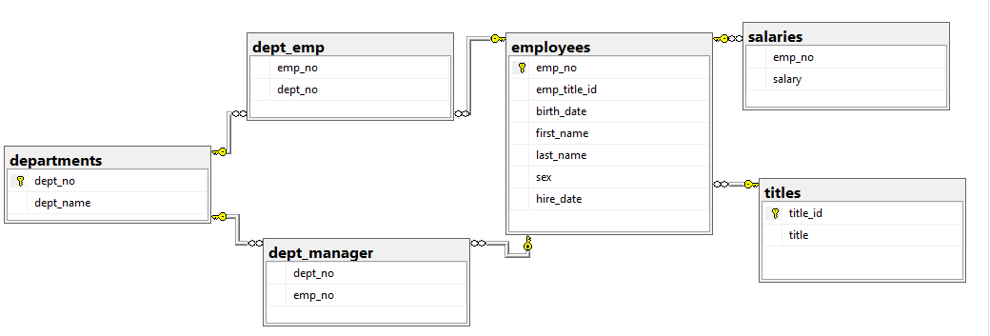
ER MODEL (DATA MODEL)

Slide 5
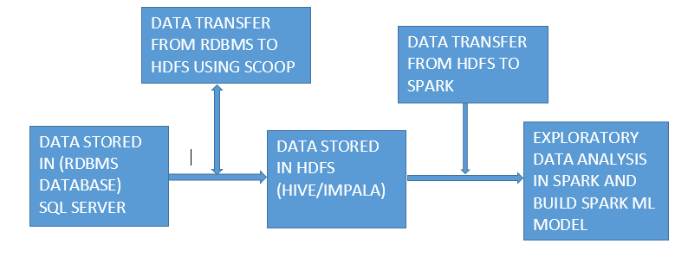
ARCHITECTURE OF PIPELINE

Slide 6
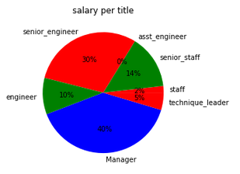
EXPLORATORY DATA ANALYSIS
Salary with respect to Title

Slide 7
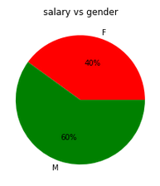
EXPLORATORY DATA ANALYSIS
SALARY WITH RESPECT TO GENDER

Slide 8
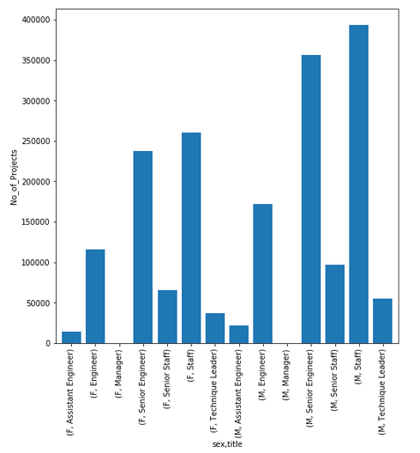
EXPLORATORY DATA ANALYSIS
NUMBER OF PROJECTS DONE WITH RESPECT TO GENDER AND TITLE

Slide 9
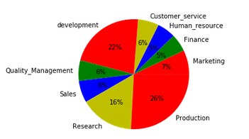
EXPLORATORY DATA ANALYSIS
NUMBER OF PROJECTS WITH RESPECT TO DEPARTMENT

Slide 10
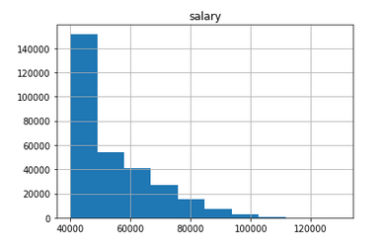
EXPLORATORY DATA ANALYSIS
HISTOGRAM ON EMPLOYEE SALARY

Slide 11
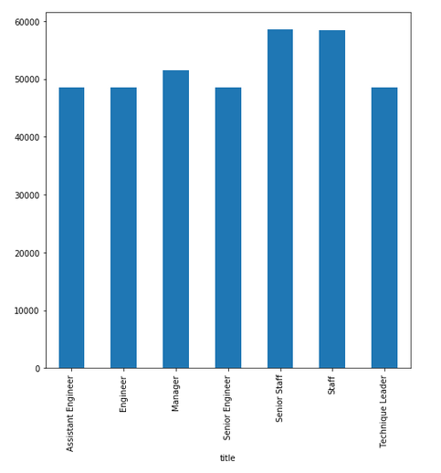
EXPLORATORY DATA ANALYSIS
AVERAGE SALARY WITH RESPECT TO TITLE

Slide 12
CHALLENGES FACED
1. IN MYSQL after creating the table and schema, loading the data in the tables some challenges faced/
2. While transferring all files in one go from MySQL to HDFS with the Sqoop Command facing some challenges because of different file formats.
3. Importing the tables into Spark from HDFS some challenges faced.
4. While doing the analysis and building the ML model some challenges faced because of some datatype change .
5. While creating the entire data pipeline some challenges faced.

